Slide 1
Walmart Store Sales Analysis
Prajakta Pawar
Dhanshri More
Rutuja magar

Slide 2
Data Pre-processing and Cleaning
Read and merge the datasets from stores.csv, train.csv and features.csv.
Convert the dates to character datatype.
Consider a baseline date as '2010-02-05' and compute the number of days for each new date in our data.
Split the given date into news columns Year, Month and Day.
Sort the dataset on the basis of Store, Department and Date.
We define four holidays viz: Labor Day, Christmas, Super Bowl and Thanksgiving.

Slide 3
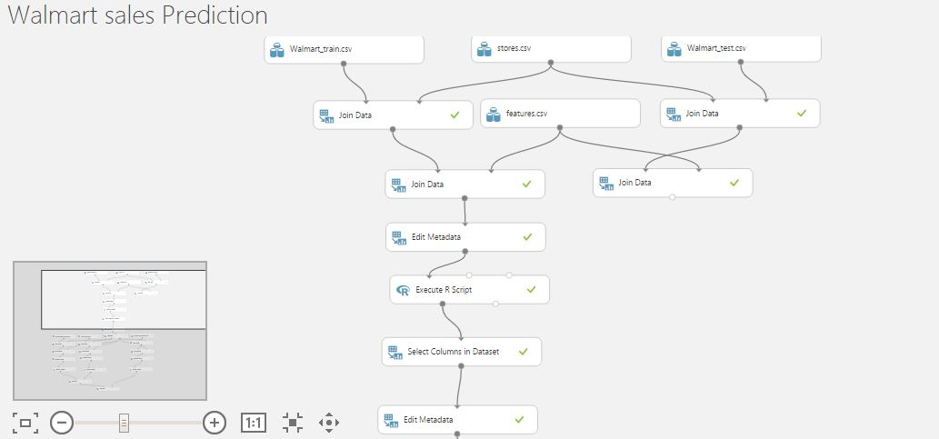
Linear Model

Slide 4
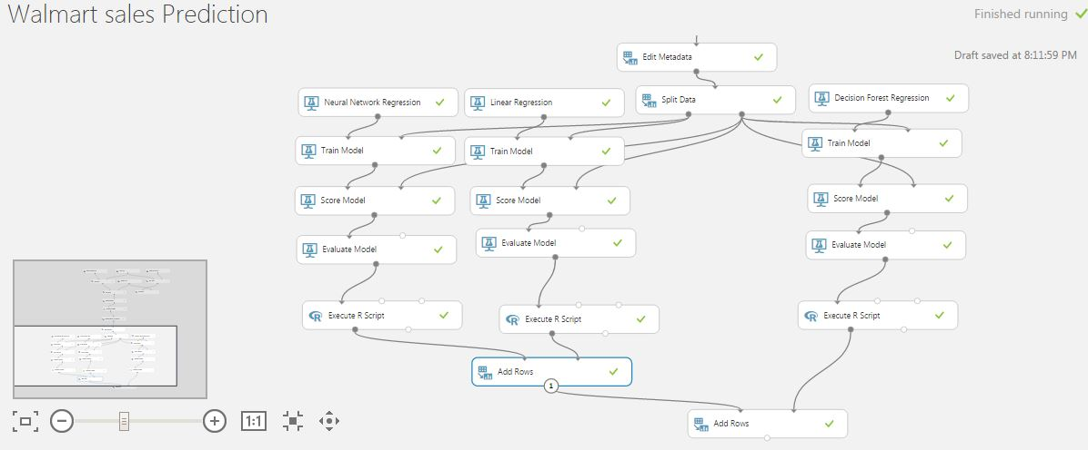

Slide 5
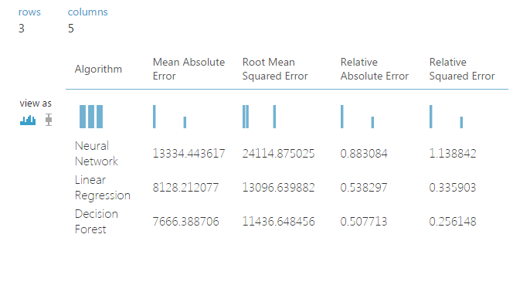
Comparative Analysis based on Performance Matrix

Slide 6
Classification

